Slide 1
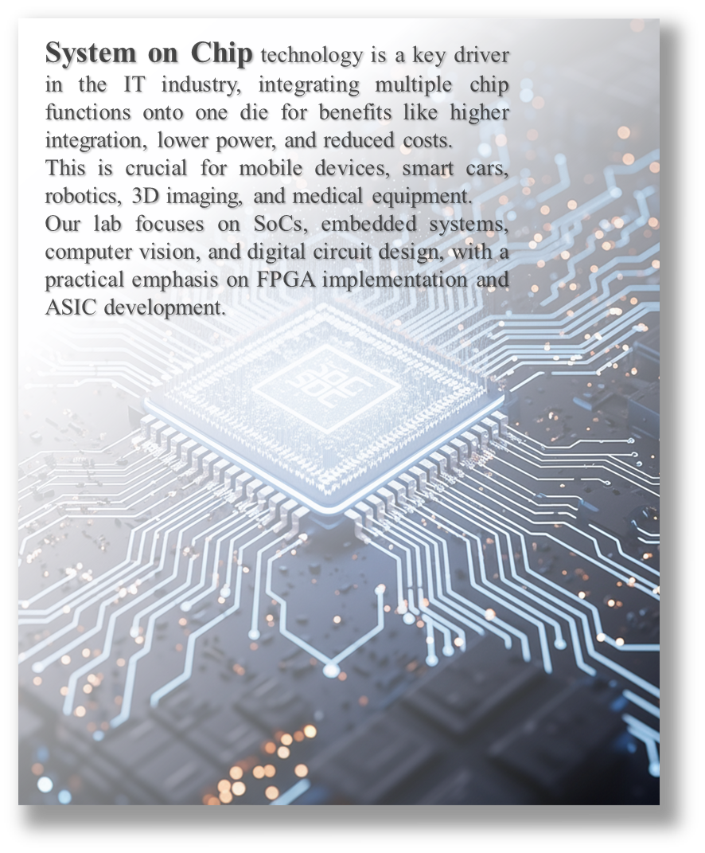

System on Chip technology is a key driver in the IT industry, integrating multiple chip functions onto one die for benefits like higher integration, lower power, and reduced costs.
This is crucial for mobile devices, smart cars, robotics, 3D imaging, and medical equipment.
Our lab focuses on SoCs, embedded systems, computer vision, and digital circuit design, with a practical emphasis on FPGA implementation and ASIC development.

Slide 2
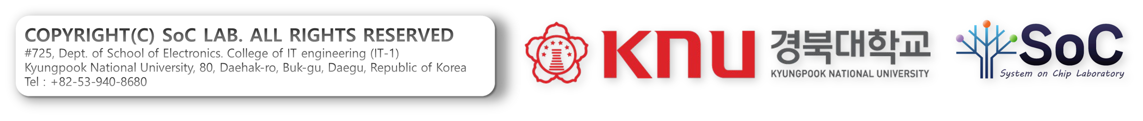
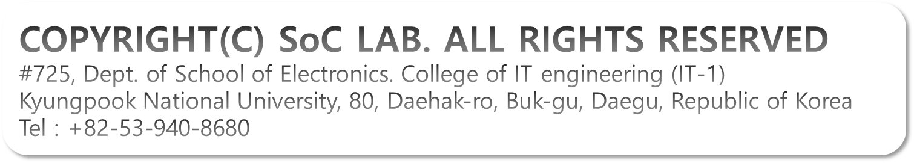

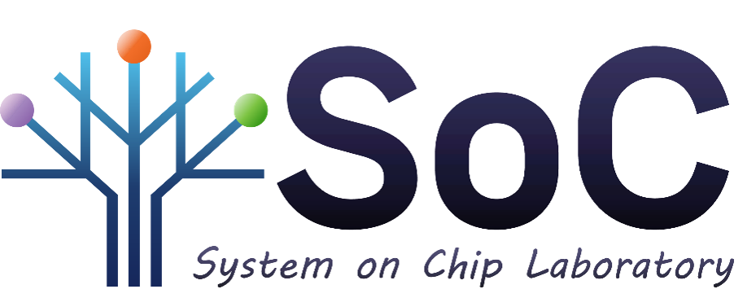
COPYRIGHT(C) SoC LAB. ALL RIGHTS RESERVED
#725, Dept. of School of Electronics. College of IT engineering (IT-1)
Kyungpook National University, 80, Daehak-ro, Buk-gu, Daegu, Republic of Korea
Tel : +82-53-940-8680

Slide 3

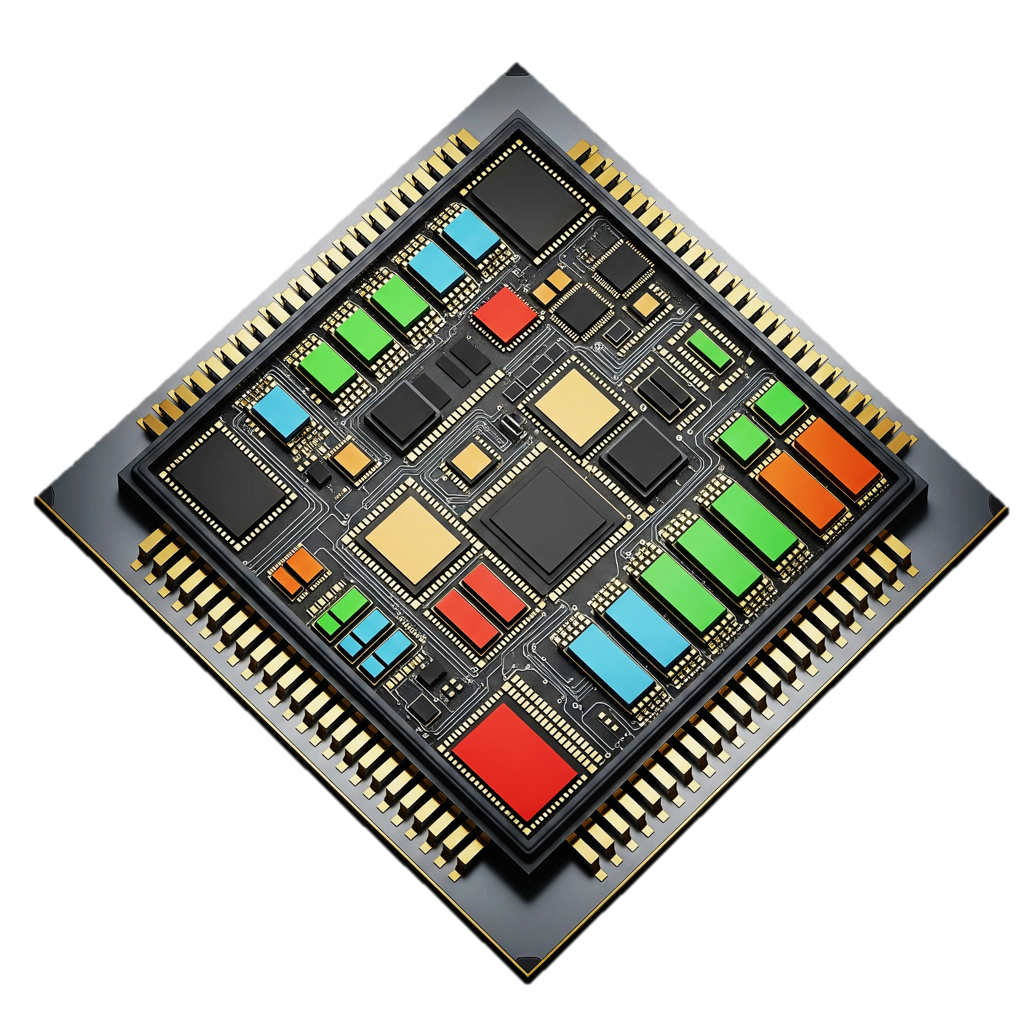
Computer Architecture
Artificial Intelligence
Mobile
Devices
Hardware
Accelerator

Slide 4
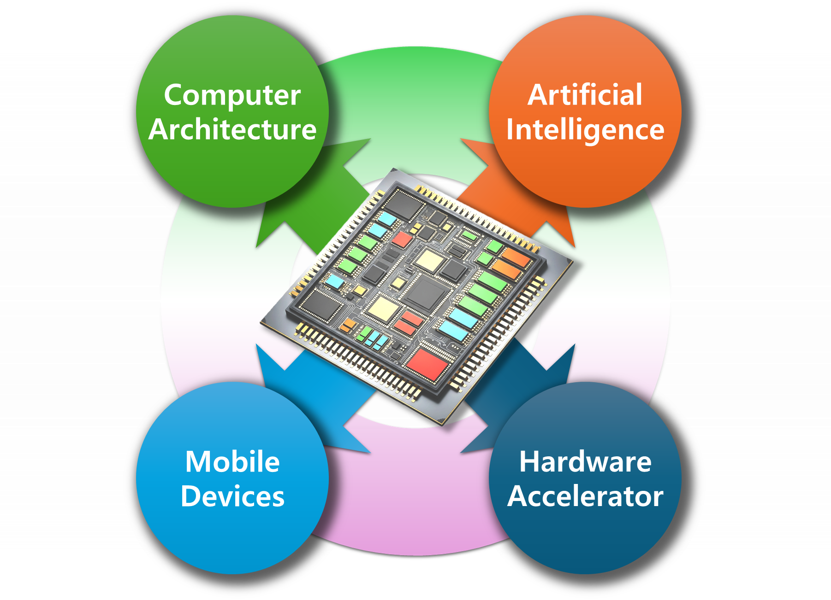
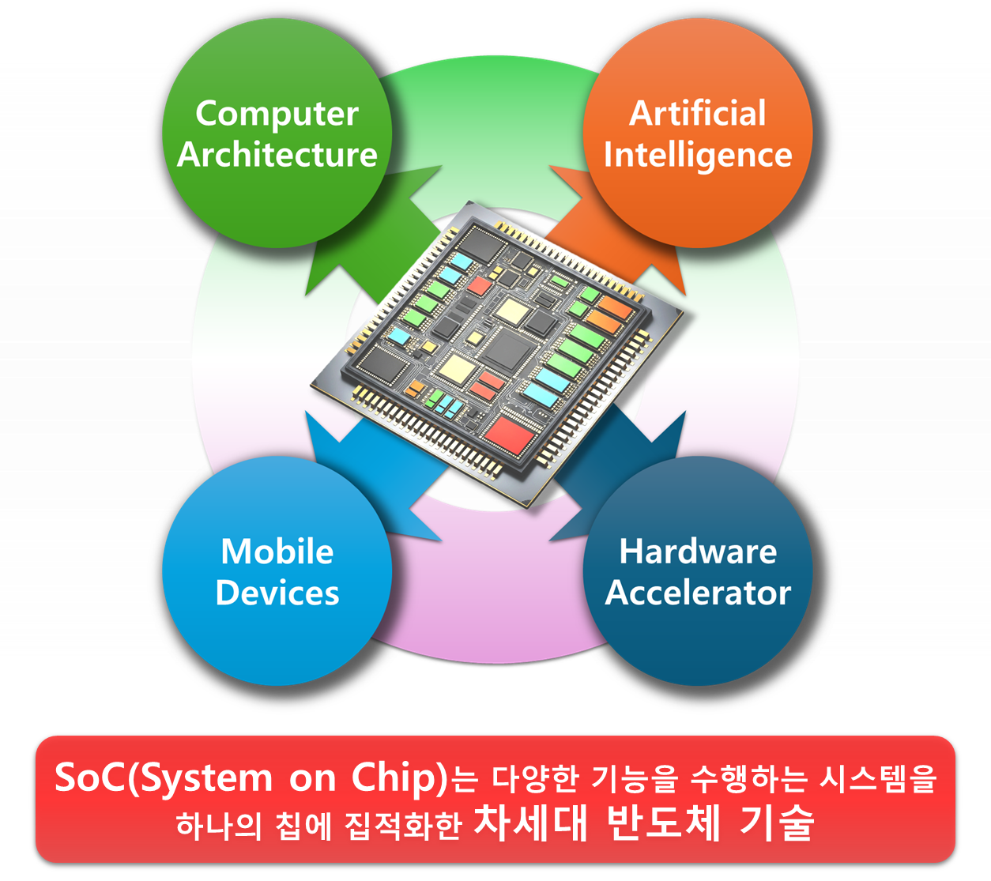
SoC(System on Chip)는 다양한 기능을 수행하는 시스템을
하나의 칩에 집적화한 차세대 반도체 기술

Slide 5
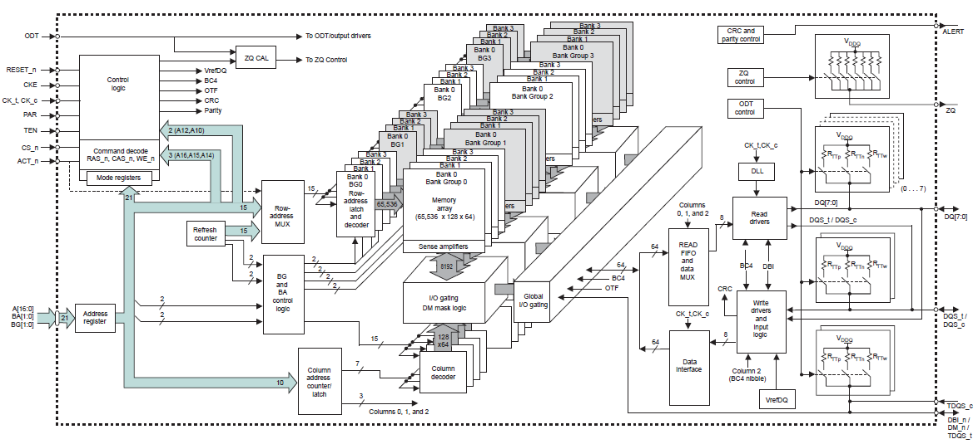

Slide 6
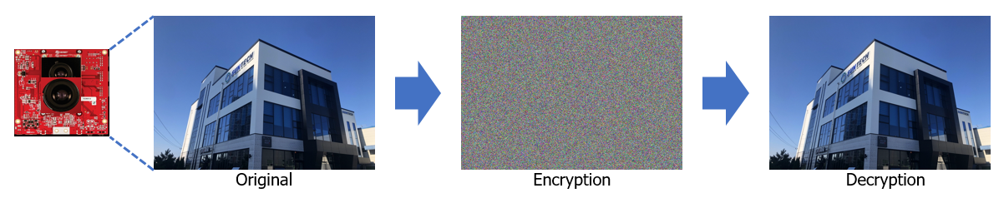

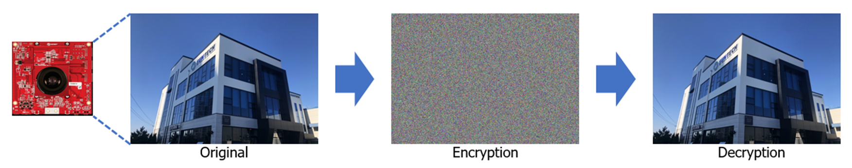

Slide 7
